Slide 1
Draft CMP ROADMAP
19 SG meeting
30th April 2013

Slide 2
Index
Surrender of contracted capacity
Long-term UIOLI mechanism

Slide 3
What is said in the Regulation...
According to article 2.2.4 of Annex I to Regulation (EC) No 715/2009:
“ TSOs shall accept any surrender of firm capacity which is contracted by the NU at an IP, with the exception of capacity products with a duration of a day and shorter.
The NU shall retain its rights and obligations under the capacity contract until the capacity is reallocated by the transmission system operator and to the extent the capacity is not reallocated by the TSO.
Surrendered capacity shall be considered to be reallocated only after all the available capacity has been allocated. The TSO shall notify the NU without delay of any reallocation of its surrendered capacity.
Specific terms and conditions for surrendering capacity, in particular for cases where several NUs surrender their capacity, shall be approved by the NRA.”

Slide 4
Capacity surrender possibilities
Product subdivision: CAM calendar implies to surrender capacity only via a shorter term product
Any capacity booked at rolling monthly auctions shall not be surrendered as there is no additional auction window to reoffer monthly products a second time

Slide 5
Monthly products surrender calendar
Possible surrender of Monthly product M
Reallocation of surrendered capacity
or
Secondary
Market
No offer at secondary market since surrender date
till the day after publication of auction results
Secondary Market
(if product not reallocated)
Month M - 2
Month M - 1
Month M
1st working day of M-1
3rd Monday of M-1
TSO informs shipper if surrendered capacity has been reallocated and invoices surrender fee
Limit to surrender Monthly product M
TSO informs shipper surrender acceptance
Rolling monthly auction
Publication of auction results
1 week after
Following working day

Slide 6
Quarterly products surrender calendar
Possible surrender of Quarterly Q
Reallocation of
surrendered capacity
Unsold surrendered Quarterly capacity can be surrendered as Monthly products
or
or
Secondary
Market
No offer at secondary market since surrender date till the day after publication of auction results
Secondary Market
(if product not reallocated)
April
May
June
1st working day of May
1st Monday of June
TSO informs shipper if surrendered capacity has been reallocated and invoices surrender fee
Limit to surrender Quarterly product Q
TSO informs shipper surrender acceptance
Annual Quarterly auction
Publication of auction results
1 week after
Following working day

Slide 7
Capacity surrender mechanism
In case, several product are surrendered, a first-come-first-served (time stamp) mechanism shall be used to decide on the order of allocation
Surrendered capacity shall be considered to be reallocated only after all the available bundled capacity has been allocated
Shippers may surrender both bundled and unbundled capacity
Surrendered unbundled capacity shall always be combined, if possible, with available unbundled capacity on the other side of the border, before it is reallocated
Surrendered bundled capacity shall not be reoffered to the market if more than 10 % of the total technical capacity at an IP remains unsold as unbundled capacity
The network user shall retain its rights and obligations under the capacity contract until the capacity is reallocated by the TSO and to the extent the capacity is not reallocated

Slide 8
Capacity surrender mechanism
Surrendered capacity products shall be definitively surrendered (and shall not be offered by shippers at the secondary market) until the TSOs communicate the results of the respective auction. If unsold, surrendered capacity is given back to the original capacity holder after the auction
A fee is to be introduced to reflect the cost of the service and to avoid a loss of revenue for the TSO. It also envisages incentivizing an efficient booking of capacity by network users
The shipper holding the original capacity would be billed for the surrender service at a level equal to the maximum of the two following amounts:
1% of the initial selling price,
the difference between the initial price of the capacity and the reallocation price (if positive)

Slide 9
Index
Surrender of contracted capacity
Long-term UIOLI mechanism

Slide 10
Background
LT UIOLI is under application in France since 2007 and in Spain since 2003. No LT UIOLI mechanism is in force in Portugal, since no long-term capacity products are available to the market.
TSOs acknowledge that harmonisation within the region is needed to adapt the rules under application to the CAM NC.
TSOs propose to start the analysis of the capacity utilisation by 2015, once the CAM NC is already implemented within the region.
For the interim period, before the start of CAM auctions, TSOs will continue with current arrangements.
The following proposition is to be considered for IPs where CAM auctions are in place

Slide 11
Application of the procedure
According article 1 of the LT UIOLI procedure, NRAs shall require TSOs to partially or fully withdraw systematically underutilised contracted capacity on an interconnection point by a network user where that user has not sold or offered under reasonable conditions its unused capacity and where other network users request firm capacity.
Thus, the ultimate responsibility to withdraw the capacity lies in the NRAs. For this purpose, TSOs will provide NRAs with all the data necessary for the application of the LT UIOLI, this information shall include at least: the utilisation of capacity contracts, a proposition for the potential capacity to be withdrawn to each network user, network users justification for not using the capacity and a proposition for the amount of capacity to be reoffered.
Once NRAs have received all the information they shall communicate TSOs the final capacities to be withdrawn and reoffered.

Slide 12
When will be the LT UIOLI triggered (I)
The LT UIOLI will be triggered, if two conditions are met:
the capacity demanded at the reserve price (P₀) for the yearly standard capacity product Y is higher than the capacity offered at the reserve price step (P₀) or all the technical capacity reserved for long-term contracts is already contracted.
the total capacity allocated under long-term contracts shall be at least 80% of the technical capacity reserved for long-term contracts.
If the annual yearly capacity auction does not take place due to the lack of available capacity, then the LT UIOLI procedure will be automatically triggered. Under this circumstance the capacity to be released shall not be limited and all the systematically underutilised capacity will be reoffered to the market.
The total amount of capacity to be released will be limited to the demand exceeding the offer at the reserve price in the annual yearly capacity auction for year Y.

Slide 13
When will be the LT UIOLI triggered (II)
Contracted capacity shall be considered to be systematically underutilised in particular if:
the network user uses less than on average 80% of its long-term contracted capacity both from 1 April Y-1 until 30 September Y-1, and from 1 October Y-1 until 31 March Y, and for which no proper justification could be provided; or
the network user systematically nominates close to 100% of its contracted capacity and renominates downwards with view to circumventing the firm day-ahead UIOLI mechanism included in Regulation.
To calculate the rate of utilisation of contracted capacity, it will be taken into account the last nomination/renomination sent by the network user to the TSOs.
In case of systematically underutilisation of contracted capacity, the network user might lose its contracted capacity for the period from 1 October Y to 30 September Y+1.

Slide 14
When will be the LT UIOLI triggered (III)
For each network user two different types of contracted capacity will subject to the LT UIOLI procedure:
Contracted capacity before the implementation of the NC on CAM with a duration of one year or more.
Contracted capacity at the annual yearly capacity auctions after the implementation of the NC on CAM.
For the purpose of the LT UIOLI procedure both capacities will be defined as Long-term Contracted Capacity.
Only capacity related to Long-term Contracted Capacity will be subject to the LT UIOLI analysis and will be released.

Slide 15
Amount of capacity to be released (I)
Long-term Contracted Capacity during the period from 1 April Y-1 until 31 March Y, divided in two semesters, will be analysed..
For each network user two different percentages of systematic underutilised capacity shall be calculated: one for summer period, from 1 April Y-1 until 30 September Y-1, and another one for winter period, from 1 October Y-1 until 31 March Y.
The Summer Percentage shall be calculated as the average of:
daily Long-term Used Capacity from 1 April Y-1 until 30 September Y-1
divided by
daily Long-term Contracted Capacity from 1 April Y-1 to 30 September Y-1.
The Winter Percentage shall be calculated as the average of:
daily Long-term Used Capacity from 1 October Y-1 until 31 March Y,
divided by
daily Long-term Contracted Capacity from 1 October Y-1 until 31 March Y.

Slide 16
Amount of capacity to be released (II)
Withdrawal might result in the network user losing part or the whole of its Long-term Contracted Capacity for year Y, from 1 October Y to 30 September Y+1.
The potential contracted capacity to be withdrawn in summer period will be calculated as:
(1 - Summer Percentage) * Long-term Contracted Capacity from 1 April Y+1 to 30 September Y+1
And, the potential capacity to be withdrawn in winter period will be calculated as:
(1 - Winter Percentage) * Long-term Contracted Capacity from 1 October Y to 31 March Y+1
If a shipper has several Long-term Capacity Contracts from October Y to September Y+1, Long-term Contracted Capacity with the highest premium shall be first withdrawn.

Slide 17
Reoffered of released capacity
The potential Long-term Contracted Capacity to be withdrawn will be again offered to the market in the annual quarterly capacity auctions.
If the withdrawn Long-term Contracted Capacity is bundled then it will be reoffered in a bundled way, whereas if the withdrawn Long-term Contracted Capacity is unbundled, then TSOs will make their best efforts in order to offer it in a bundled way.
Released capacity through the LT UIOLI procedure will only be allocated once all the available capacity and surrender capacity offered in the annual quarterly capacity auctions has been exhausted.

Slide 18
Contractual obligations
During the period between the annual yearly capacity auctions and the annual quarterly capacity auctions, network users will not be allowed to propose at the secondary market or through the surrender procedure capacity withdrawn following the LT UIOLI rules. If withdrawn capacity is not reallocated by the TSO after the annual quarterly capacity auctions, the network user will recover its rights under the capacity contract.
If the clearing price of the reallocated capacity is lower than the clearing price of the capacity initially allocated, the initial holder of the capacity will retain its payment obligations for the difference of clearing prices.
If the clearing price of the reallocated capacity is higher than the clearing price of the capacity initially allocated, the initial holder of the capacity will be released of all its rights and obligations under the capacity contract, including all payment obligations.

Slide 19
Main deadlines
1st Monday of June: annual quarterly capacity auctions including capacity released through LT UIOLI
1st Monday of March: annual yearly capacity auctions
2 weeks before the annual quarterly auctions start: TSOs shall notify the amount of capacity to be offered
Once the annual quarterly capacity auction has finished: TSOs shall communicate shippers the final allocation and the capacity withdrawn
March
April
May
June
July
TSOs to trigger the UIOLI procedure
20 March: TSOs shall analyse the capacity demanded in the annual yearly capacity auctions at one particular point and direction
10th April: TSOs shall informed affected shippers
No latter than 20th April: Affected shippers shall properly justify their behavior as regards the capacity utilisation
No later than 1st May: TSOs shall send NRAs all relevant information as regards the long-term capacity utilisation contracts
No later than 10th May: NRAs shall confirm TSOs the amount of capacity to be released from shippers

Slide 20
Example
1
Annual yearly capacity auctions (March 2015)
Capacity auctioned at the annual yearly capacity auctions for year 2016 (1 October 2016 to 30 September 2017): 7,500 kWh/day
Results of the auction:
Price Step | Capacity offered | Capacity demanded
P3 | 7,500 | 1,000
P2 | 7,500 | 3,000
P1 | 7,500 | 7,000
P0 | 7,500 | 9,000
Clearing price P1
Maximun amount of capacity to be released: 1,500 kWh/day

Slide 21
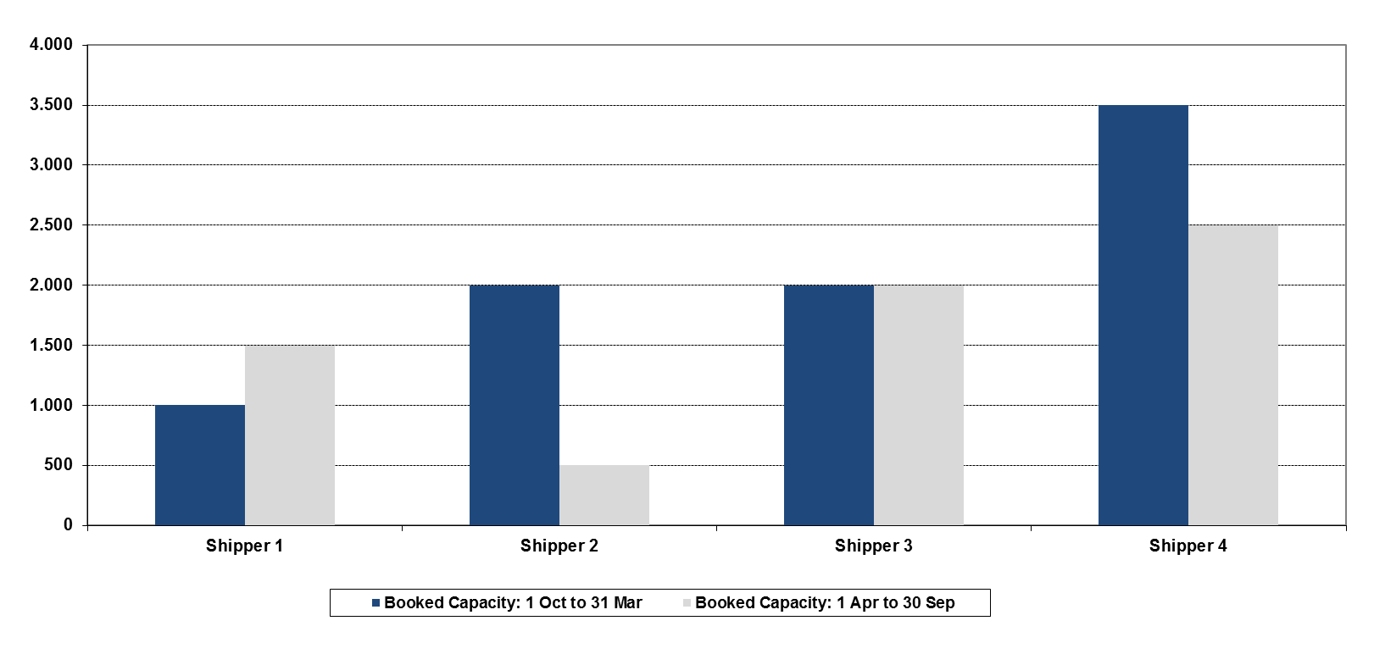
Example
2
Initial capacity booked
Capacity booked by 4 shippers during 1 April 2014 to 31 March 2015

Slide 22
Example
3
TSOs jointly study the utilisation rates of the contracts
Shipper 1
Shipper 2
Shipper 3
Shipper 4
Capacity shall be released
Winter and summer utilisation rates of shipper 2 and shipper 3 are below 80%

Slide 23
Example
4
Reduction of capacity to Shipper 2
Month | Daily contracted capacity (kWh/d) | Daily used capacity (kWh/d) | Daily used capacity (% referred to monthly contracted capacity) | Annual utilisation rate | Winter percentage | Summer percentage
Shipper 2 | Jul | 500 | 90 | 18% | 41.42% | 74.17% | 8.67%
 | Ago | 500 | 80 | 16%
 | Sep | 500 | 10 | 2%
 | Oct | 2,000 | 1,000 | 50%
 | Nov | 2,000 | 1,500 | 75%
 | Dec | 2,000 | 1,700 | 85%
 | Jan | 2,000 | 1,700 | 85%
 | Feb | 2,000 | 1,000 | 50%
 | Mar | 2,000 | 2,000 | 100%
 | Apr | 500 | 10 | 2%
 | May | 500 | 60 | 12%
 | Jun | 500 | 10 | 2%
Summer Percentage: 8.67%
Winter Percentage: 74.17%
Note that this example only includes monthly capacities, however it should be carried out with daily capacities

Slide 24
Example
4
Reduction of capacity to Shipper 3
Month | Daily contracted capacity (kWh/d) | Daily used capacity | Daily used capacity (% referred to monthly contracted capacity) | Annual utilisation rate | Winter percentage | Summer percentage
Shipper 3 | Jul | 2.000 | 500 | 25% | 47.92% | 20.00% | 75.83%
 | Ago | 2.000 | 2.000 | 100%
 | Sep | 2.000 | 1.000 | 50%
 | Oct | 2.000 | 100 | 5%
 | Nov | 2.000 | 300 | 15%
 | Dec | 2.000 | 0 | 0%
 | Jan | 2.000 | 0 | 0%
 | Feb | 2.000 | 0 | 0%
 | Mar | 2.000 | 2.000 | 100%
 | Apr | 2.000 | 2.000 | 100%
 | May | 2.000 | 2.500 | 125%
 | Jun | 2.000 | 1.100 | 55%
Summer Percentage: 75.83%
Winter Percentage: 20.00%
Note that this example only includes monthly capacities, however it should be carried out with daily capacities

Slide 25
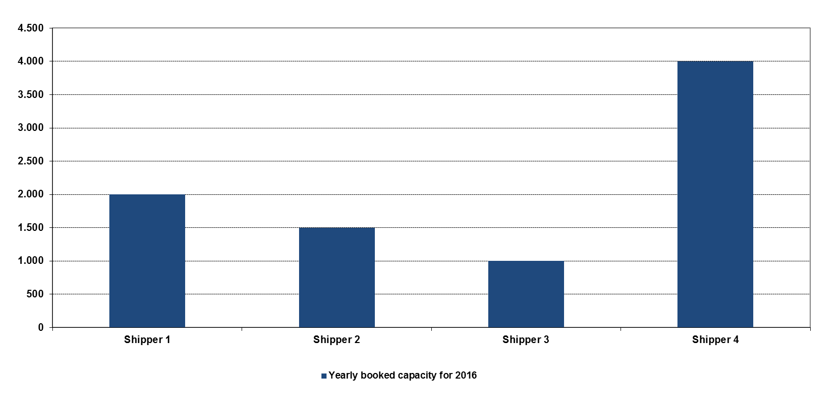
Example
5
Yearly capacity for the 2016 gas year already booked

Slide 26
Example
5
Maximum potential capacity to be withdrawn
Lower than 1,500 GWh/d
No prorata is needed
388
800
Shipper 1
Shipper 2
Shipper 3
Shipper 4

Slide 27
Example
5
Maximum potential capacity to be withdrawn
Higher than 1,500 GWh/d
Prorata is needed
1,370
242
Shipper 1
Shipper 2
Shipper 3
Shipper 4

Slide 28
Example
5
Potential capacity to be withdrawn
388
1,275
800
225
Shipper 1
Shipper 2
Shipper 3
Shipper 4

Slide 29
Example
6
Capacity offered in the annual quarterly capacity auctions
Capacity auctioned at the quarterly capacity auctions for year 2016:
Quarter | Available capacity | Capacity released through LT UIOLI | Total capacity to be offered
Q1 (1 October 2016 to 31 December 2017) | 2,500 | 1,188 | 3,688
Q2 (1 January 2017 to 31 March 2017) | 1,000 | 1,188 | 2,188
Q3 (1 April 2017 to 30 June 2017) | 500 | 1,500 | 2,000
Q4 (1 July 2017 to 30 September 2017) | 2,000 | 1,500 | 3,000

Slide 30
Example
6
Annual quarterly capacity auctions
Quarter 1
Quarter 2
Price Step | Capacity offered | Capacity demanded
P2 | 3,688 | 3,000
P1 | 3,688 | 7,000
P0 | 3,688 | 9,000
Price Step | Capacity offered | Capacity demanded
P2 | 2,500 | 500
P1 | 2,500 | 1,100
P0 | 2,188 | 4,000
Clearing price P2
Clearing price P1
Quarter 3
Quarter 4
Price Step | Capacity offered | Capacity demanded
P2 | 2,000 | 3,000
P1 | 2,000 | 2,000
P0 | 2,000 | 4,000
Price Step | Capacity offered | Capacity demanded
P2 | 3,000 | 2,500
P1 | 3,000 | 4,000
P0 | 3,000 | 4,000
Clearing price P2
Clearing price P1

Slide 31
Example
6
Annual quarterly capacity auctions
Quarter 1
Price Step | Capacity offered | Capacity demanded
P2 | 3,688 | 3,000
P1 | 3,688 | 7,000
P0 | 3,688 | 9,000
Clearing price P2
Allocated capacities for Q1:
2,500 kWh/day
500 kWh/day from the application of LT UIOLI

Slide 32
Example
6
Annual quarterly capacity auctions
Quarter 2
Price Step | Capacity offered | Capacity demanded
P2 | 2,500 | 500
P1 | 2,500 | 1,100
P0 | 2,500 | 4,000
Clearing price P1
Allocated capacities for Q2:
1,000 kWh/day
100 kWh/day from the application of LT UIOLI

Slide 33
Example
6
Annual quarterly capacity auctions
Quarter 3
Price Step | Capacity offered | Capacity demanded
P2 | 2,000 | 3,000
P1 | 2,000 | 2,000
P0 | 2,000 | 4,000
Clearing price P1
Allocated capacities for Q3:
500 kWh/day
1,500 kWh/day from the application of LT UIOLI

Slide 34
Example
6
Annual quarterly capacity auctions
Quarter 4
Price Step | Capacity offered | Capacity demanded
P2 | 3,500 | 2,500
P1 | 3,500 | 4,000
P0 | 3,500 | 4,000
Clearing price P2
Allocated capacities for Q4:
2,000 kWh/day
500 kWh/day from the application of LT UIOLI

Slide 35
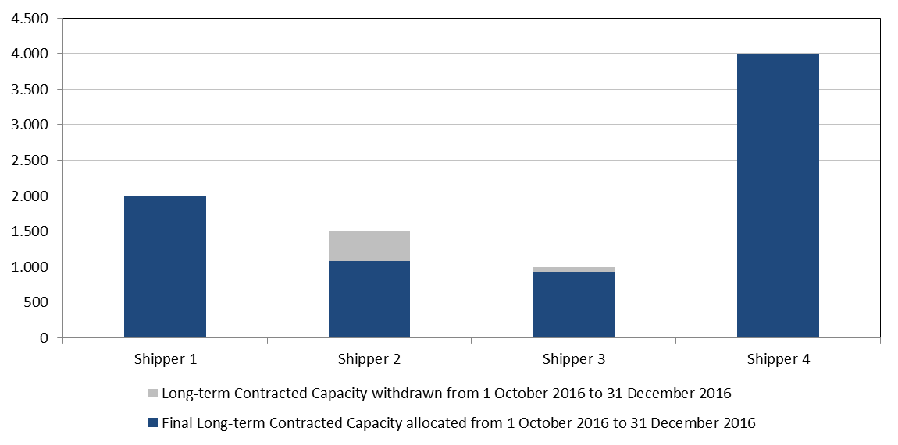
Example
6
Final allocated capacities
Quarter 1

Slide 36
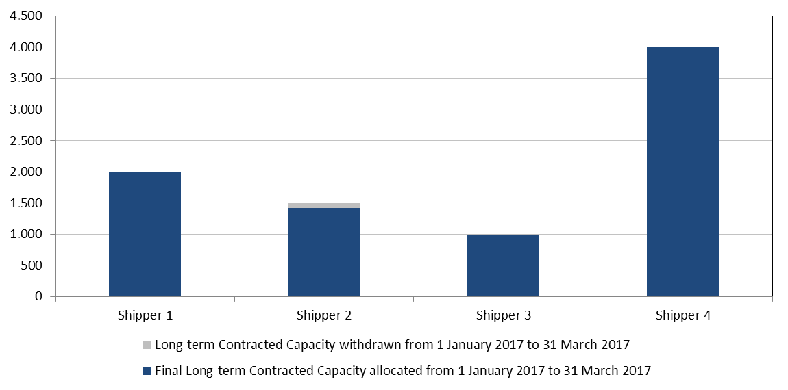
Example
6
Final allocated capacities
Quarter 2

Slide 37
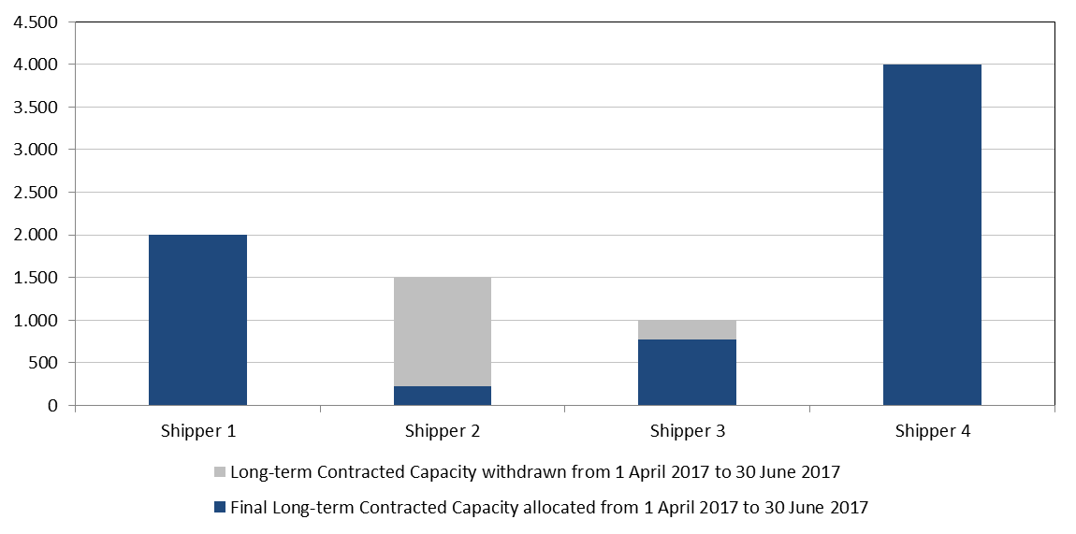
Example
6
Final allocated capacities
Quarter 3

Slide 38
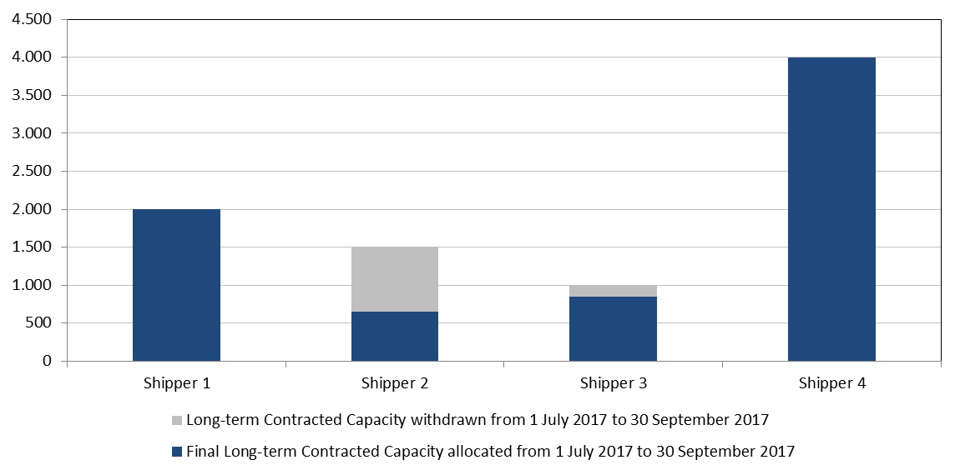
Example
6
Final allocated capacities
Quarter 4

Slide 39
Thank you for your attention!
Notes:
39

